Slide 1
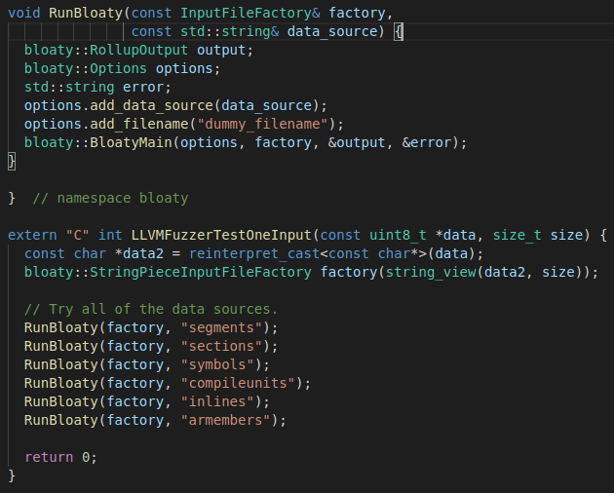
Fuzzing bloaty: driver/target
Fuzzing BloatyMain
Target function
(tester written)
Actual target
Run bloaty with various options
of unit to calculate the size

Slide 2
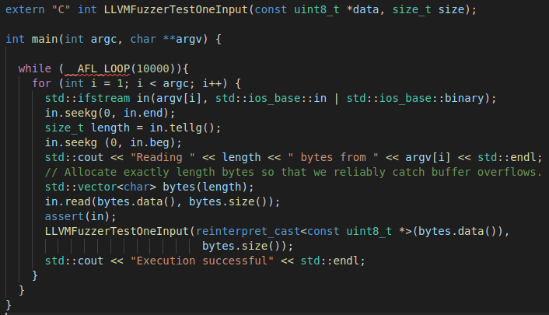
Fuzzing bloaty: driver/target
Driver including the main function invoking the target function
Stuffs for read/handle input file
(tester written)
For persistent
mode
Invoking the target function

Slide 3
Crashes in bloaty Found by AFL++
global-buffer-overflow (produced by ASAN)
illegal instruction

Slide 4
Crashes in bloaty Found by AFL++
global-buffer-overflow (produced by ASAN)
found by both normal and persistent mode with 3 hours time-limit
only two out of four fuzzing campaigns can find
no significant difference between normal and persistent mode

Slide 5
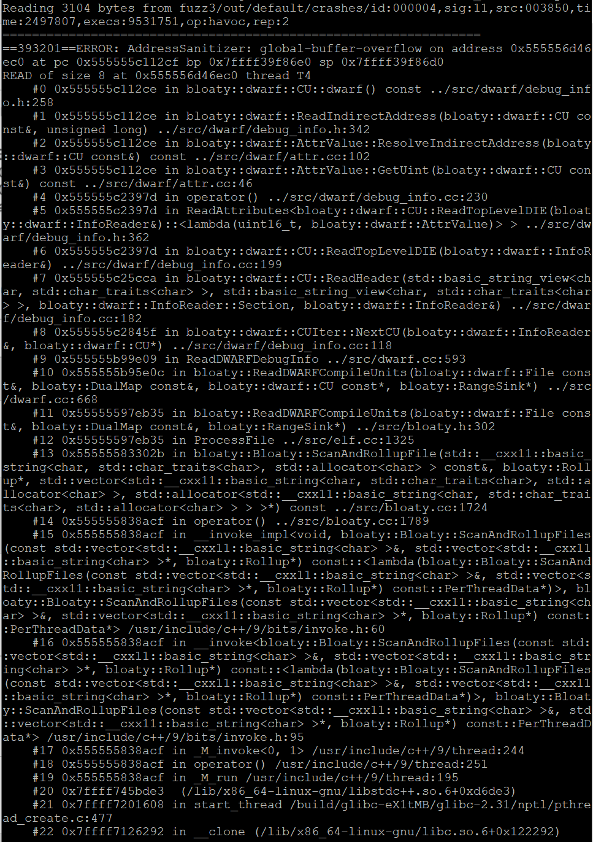
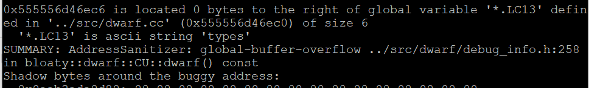
Crashes in bloaty Found by AFL++
global-buffer-overflow (produced by ASAN)
…

Slide 6
Crashes in bloaty Found by AFL++
illegal instruction
Not yet found the actual source of crash but, may be insignificant

Slide 7
Progress of the Longer (12 hours) Time-limit Fuzzing for bloaty
Both normal and persistent mode cannot find any meaningful crashes (such as global-buffer-overflow)
Significant speed improvement of persistent mode compared to normal mode
which does not be shown in 3 hours time-limit case
 | exec/sec | bitmap_cvg | stability
Normal mode | 41.00 | 11.81% | 100.00%
Persistent mode | 635.15 | 14.78% | 99.96%
Due to erroneous configuration which I made?

Slide 8
Progress for Global Variable Re-initialization
Plan to use LLVM pass
LLVM bitcode level instrumentation

Slide 9
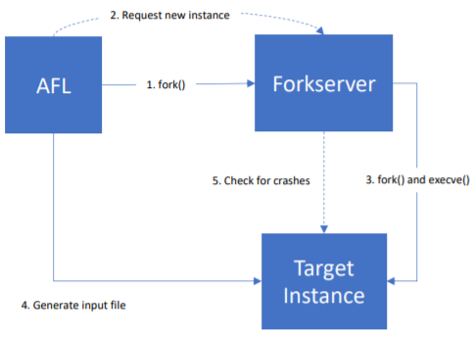
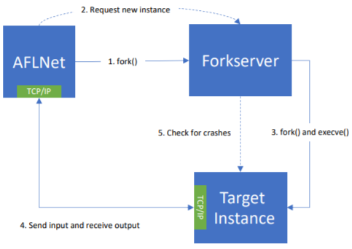
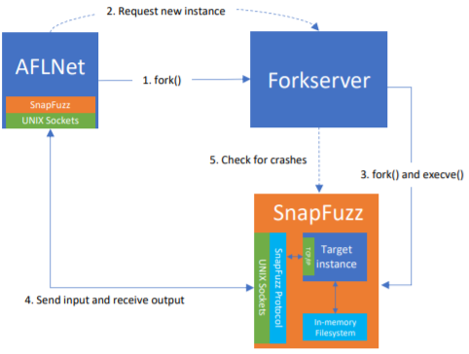
Interesting Related Work
SnapFuzz: An Efficient Fuzzing Framework for Network Application (Anastasios Andronidis and Cristian Cadar, UCL)
Eliminate user-provided clean-up scripts by using in-memory filesystem for network application
Automatically defer the forkserver to the latest point at which it is safe to start it
Overview: AFL
Overview: AFLNet
Overview: SnapFuzz
Global variable re-initialization may be insufficient for programs using filesystem

